Slide 1
Giugno 2021
METEO-HUB: Formazione per i Centri funzionali regionali e servizi ARPA settore meteo
Visualizzazione e mappe
Michele Bottazzi

Slide 2
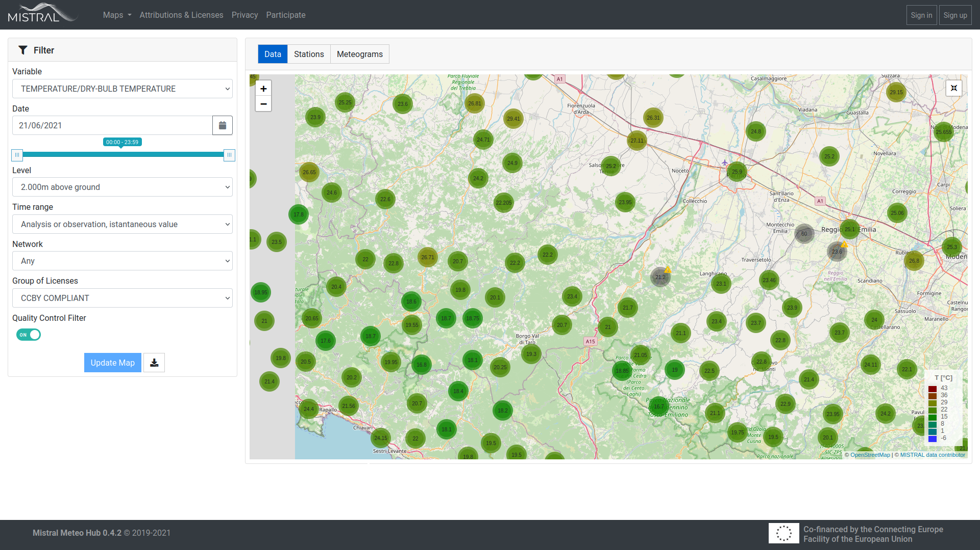
OBSERVATION
VARIABLES:
PRECIPITATION
AIR TEMPERATURE (2M)
WIND
ATMOSPHERIC PRESSURE
RADIATION
RH
SNOWFALL
LEVELS ABOVE SURFACE:
2 METERS
10 METERS
...
TIMERANGE:
REAL-TIME VALUE
DAILY OR HOURLY VALUE (MAXIMUM/MINIMUM/MEAN)
REGIONAL NETWORK
LICENSE SELECTOR
ENABLE QUALITY CONTROL FILTER

Slide 3
INTRODUCTION
STATIC PLOT
Pros:
Mainly .png format
Created offline
Easy to integrate in a web page
Availability of meteorological plotting package (magics)
Pros:
Resolution change with zoom
Interaction with layers
Image can be plotted on web maps
Pros:
produced using PNG tiles (webmap format)
Created with Magics (ECMWF)
No resolution lost with zoom
Easily layers superimposition
Cons:
Decrease in resolution with zoom (where available)
no interaction
Lack of webmap
Cons:
Created at runtime, quite high computational cost
Difficult layer superimposition
Lack of packages for meteorological applications
Cons:
Fixed number of zoom available
Layer not responsive
INTERACTIVE PLOT
METEOTILES

Slide 4
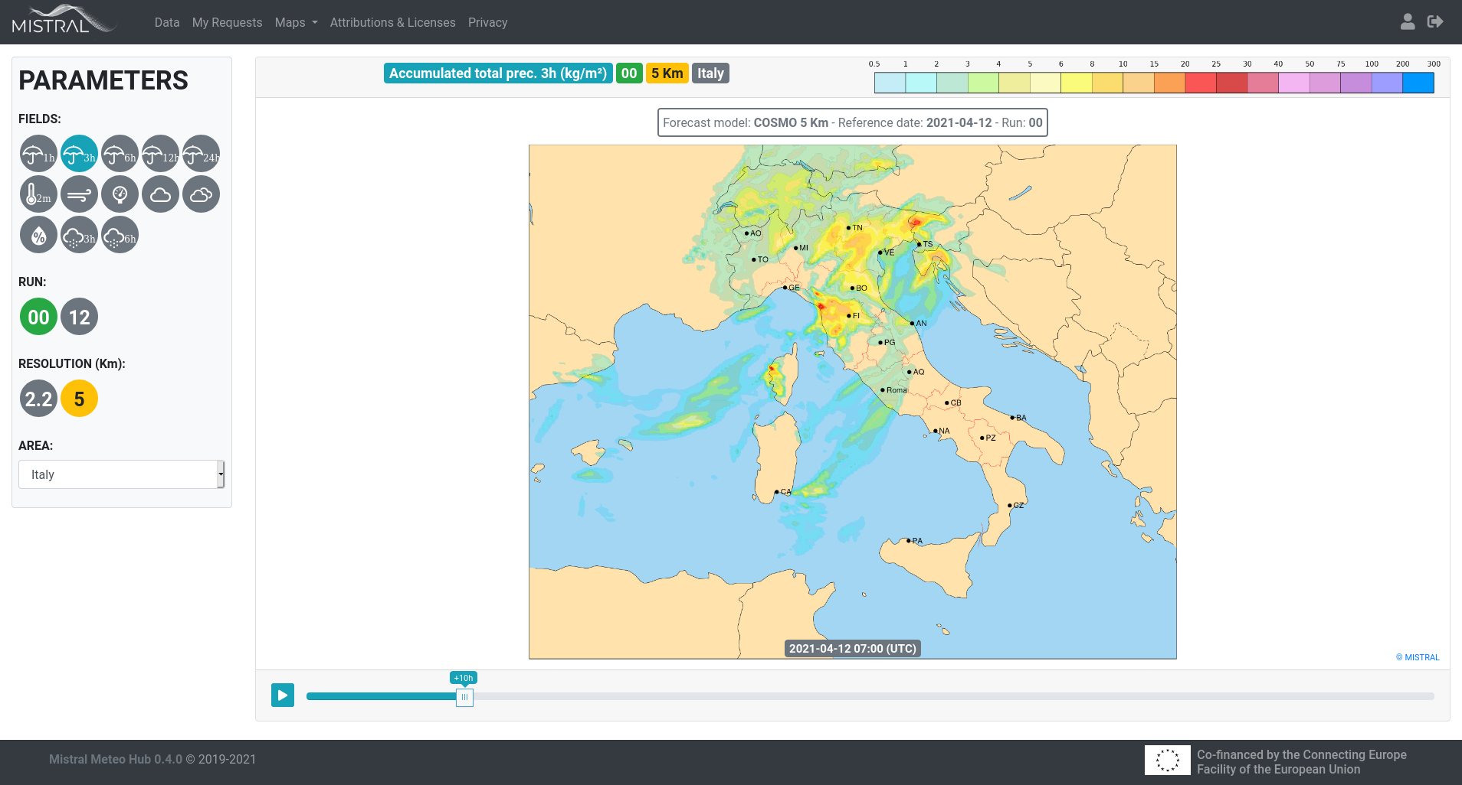
FORECAST
MODEL FIELDS:
PRECIPITATION
AIR TEMPERATURE (2M)
WIND
ATMOSPHERIC PRESSURE
CLOUD COVER
RH
SNOWFALL
MODEL RUN
MODEL RESOLUTION
AREA SELECTOR:
ITALY
NORTHERN ITALY
CENTRAL ITALY
SOUTHERN ITALY
MEDITERRANEAN REGION

Slide 5
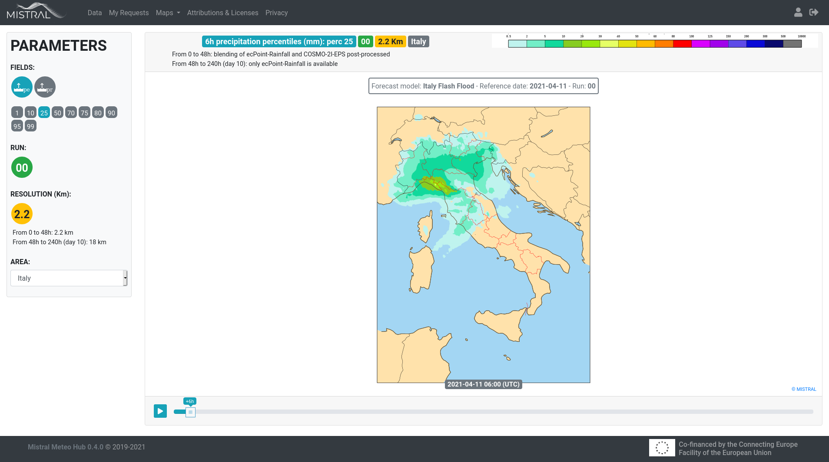
IFF
MODEL FIELDS:
PRECIPITATION PROBABILITY
PRECIPITATION PERCENTILE
MODEL RUN
MODEL RESOLUTION
AREA SELECTOR:
ITALY
NORTHERN ITALY
CENTRAL ITALY
SOUTHERN ITALY

Slide 6
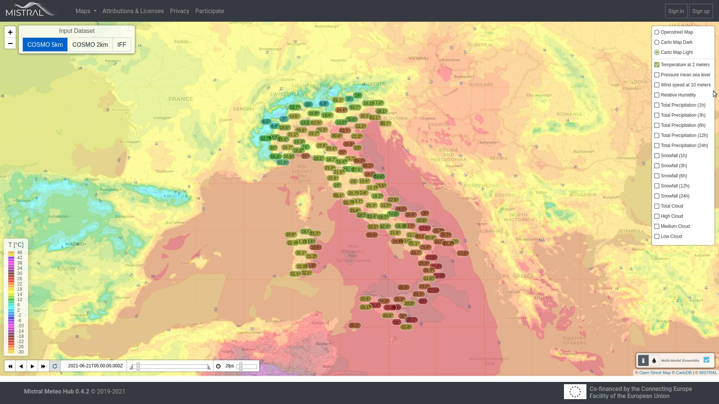
MULTI LAYER MAPS
MODEL FIELDS:
PRECIPITATION
AIR TEMPERATURE
ATMOSPHERIC PRESSURE
CLOUD COVER
RH
SNOWFALL
-----------------------------------------
PRECIPITATION PROBABILITY
PRECIPITATION PERCENTILE
DATASET SELECTOR
MULTI MODEL:
AIR TEMPERATURE
RH

